Slide 1
cards
Taught by Yossef Ayman Zedan

Slide 2
About
A card is a flexible and extensible content container. It includes options for headers and footers, a wide variety of content, contextual background colors, and powerful display options. If you’re familiar with Bootstrap 3, cards replace our old panels, wells, and thumbnails. Similar functionality to those components is available as modifier classes for cards.

Slide 3
Example
Cards are built with as little markup and styles as possible, but still manage to deliver a ton of control and customization. Built with flexbox, they offer easy alignment and mix well with other Bootstrap components. They have no margin by default, so use spacing utilities as needed.
<div class="card" style="width: 18rem;">
<img src="..." class="card-img-top" alt="...">
<div class="card-body"> <h5 class="card-title">Card title</h5>
<p class="card-text">Some quick example text to build on the card title and make up the bulk of the card's content.</p>
<a href="#" class="btn btn-primary">Go somewhere</a>
</div>
</div>

Slide 4
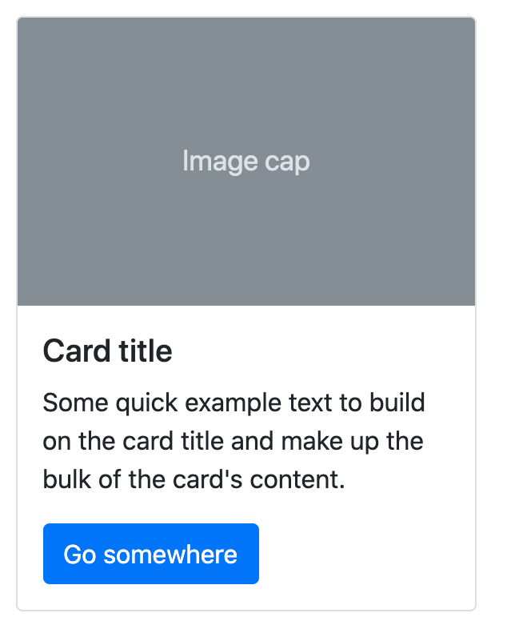
Example

Slide 5

Body
The building block of a card is the .card-body. Use it whenever you need a padded section within a card.
<div class="card">
<div class="card-body"> This is some text within a card body.
</div>
</div>

Slide 6
Titles, text, and links
Card titles are used by adding .card-title to a <h*> tag. In the same way, links are added and placed next to each other by adding .card-link to an <a> tag.
Subtitles are used by adding a .card-subtitle to a <h*> tag. If the .card-title and the .card-subtitle items are placed in a .card-body item, the card title and subtitle are aligned nicely.
<div class="card" style="width: 18rem;">
<div class="card-body"> <h5 class="card-title">Card title</h5>
<h6 class="card-subtitle mb-2 text-muted">Card subtitle</h6>
<p class="card-text">Some quick example text to build on the card title and make up the bulk of the card's content.</p>
<a href="#" class="card-link">Card link</a>
<a href="#" class="card-link">Another link</a> </div> </div>

Slide 7
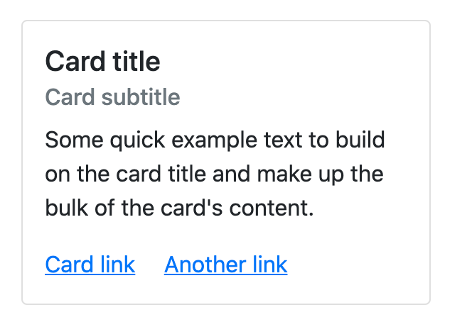
Titles, text, and links

Slide 8
Images
.card-img-top places an image to the top of the card. With .card-text, text can be added to the card. Text within .card-text can also be styled with the standard HTML tags.
<div class="card" style="width: 18rem;">
<img src="..." class="card-img-top" alt="...">
<div class="card-body">
<p class="card-text">Some quick example text to build on the card title and make up the bulk of the card's content.</p>
</div>
</div>

Slide 9
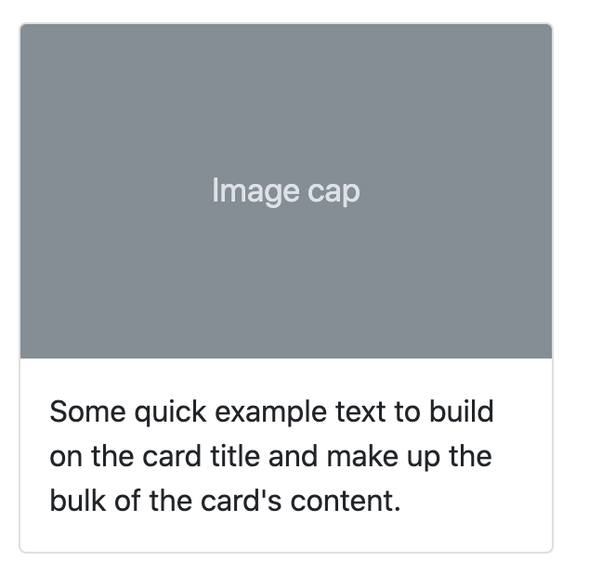
Images

Slide 10
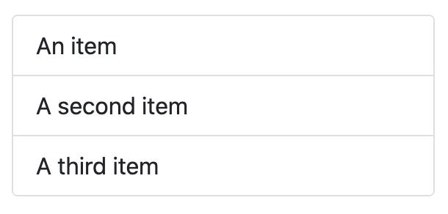
List groups
Create lists of content in a card with a flush list group.
<div class="card" style="width: 18rem;">
<ul class="list-group list-group-flush">
<li class="list-group-item">An item</li>
<li class="list-group-item">A second item</li>
<li class="list-group-item">A third item</li>
</ul>
</div>

Slide 11
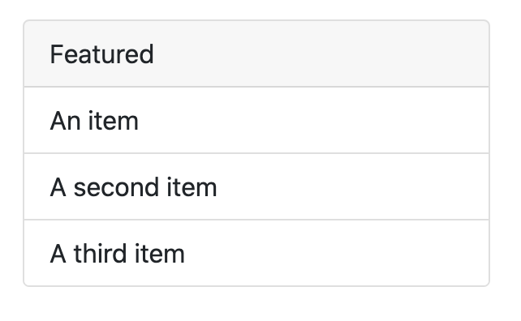
List groups with header
<div class="card" style="width: 18rem;">
<div class="card-header"> Featured </div>
<ul class="list-group list-group-flush">
<li class="list-group-item">An item</li>
<li class="list-group-item">A second item</li>
<li class="list-group-item">A third item</li>
</ul> </div>

Slide 12
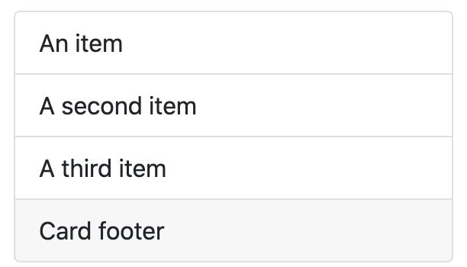
List groups with footer
<div class="card" style="width: 18rem;">
<ul class="list-group list-group-flush">
<li class="list-group-item">An item</li>
<li class="list-group-item">A second item</li>
<li class="list-group-item">A third item</li>
</ul> <div class="card-footer"> Card footer </div>
</div>

Slide 13
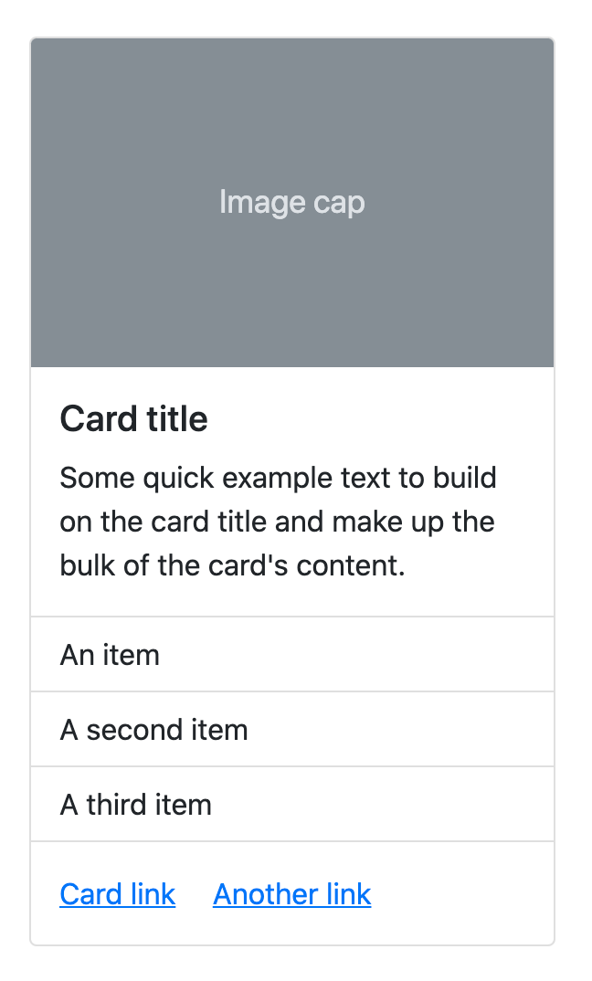
Kitchen sink
Mix and match multiple content types to create the card you need, or throw everything in there. Shown below are image styles, blocks, text styles, and a list group—all wrapped in a fixed-width card.
<div class="card" style="width: 18rem;">
<img src="..." class="card-img-top" alt="...">
<div class="card-body">
<h5 class="card-title">Card title</h5>
<p class="card-text">Card content.</p>
</div> <ul class="list-group list-group-flush">
<li class="list-group-item">An item</li>
<li class="list-group-item">A second item</li>
<li class="list-group-item">A third item</li>
</ul> <div class="card-body">
<a href="#" class="card-link">Card link</a>
<a href="#" class="card-link">Another link</a>
</div> </div>

Slide 14
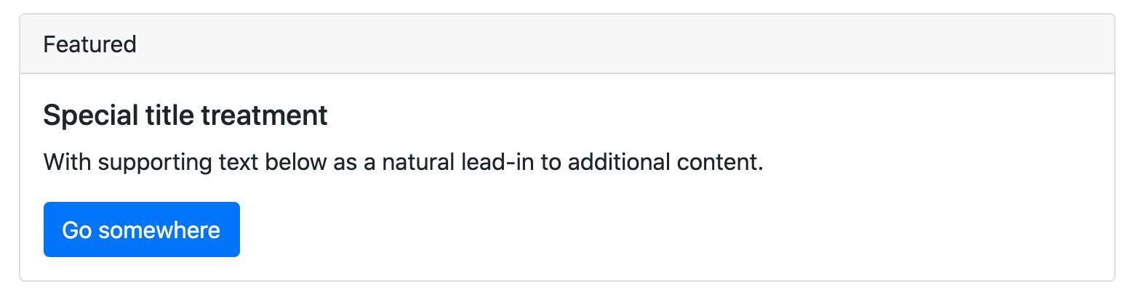
Header and footer
Add an optional header and/or footer within a card. Note: Card headers can be styled by adding .card-header to <h*> elements and text alignment can be used
<div class="card">
<div class="card-header"> Featured </div>
<div class="card-body">
<h5 class="card-title">Special title treatment</h5>
<p class="card-text">With supporting text below as a natural lead-in to additional content.</p> <a href="#" class="btn btn-primary">Go somewhere</a>
</div> </div>

Slide 15
Using grid markup
We can use grid system to add layout of cards
<div class="row">
<div class="col-sm-6">
<div class="card"> <div class="card-body"> <h5 class="card-title">Special title treatment</h5>
<p class="card-text">Card content</p>
<a href="#" class="btn btn-primary">Go somewhere</a>
</div> </div> </div>
<div class="col-sm-6">
<div class="card">
<div class="card-body">
<h5 class="card-title">Special title treatment</h5>
<p class="card-text">With supporting text below as a natural lead-in to additional content.</p>
<a href="#" class="btn btn-primary">Go somewhere</a> </div> </div> </div> </div>

Slide 16
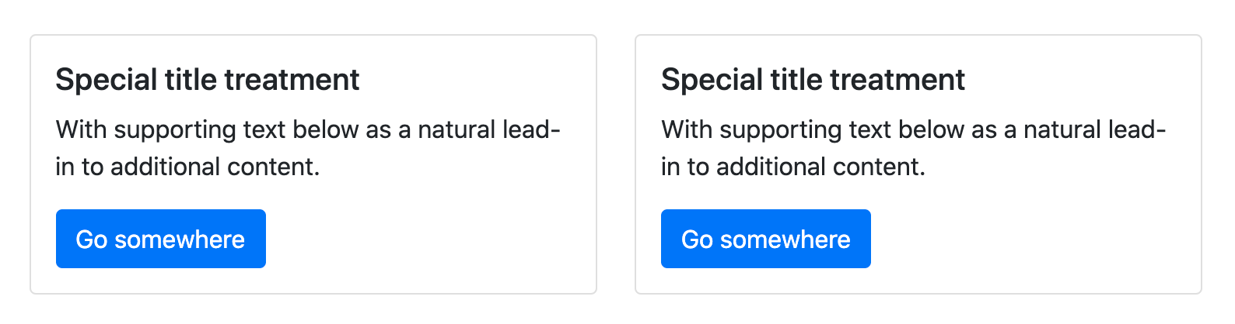
Using grid markup

Slide 17
Using utilities
We can used w-* to control the width of the card
<div class="card w-75">
<div class="card-body">
<h5 class="card-title">Card title</h5>
<p class="card-text">With supporting text below as a natural lead-in to additional content.</p>
<a href="#" class="btn btn-primary">Button</a> </div> </div>
<div class="card w-50">
<div class="card-body">
<h5 class="card-title">Card title</h5>
<p class="card-text">With supporting text below as a natural lead-in to additional content.</p>
<a href="#" class="btn btn-primary">Button</a></div> </div>

Slide 18
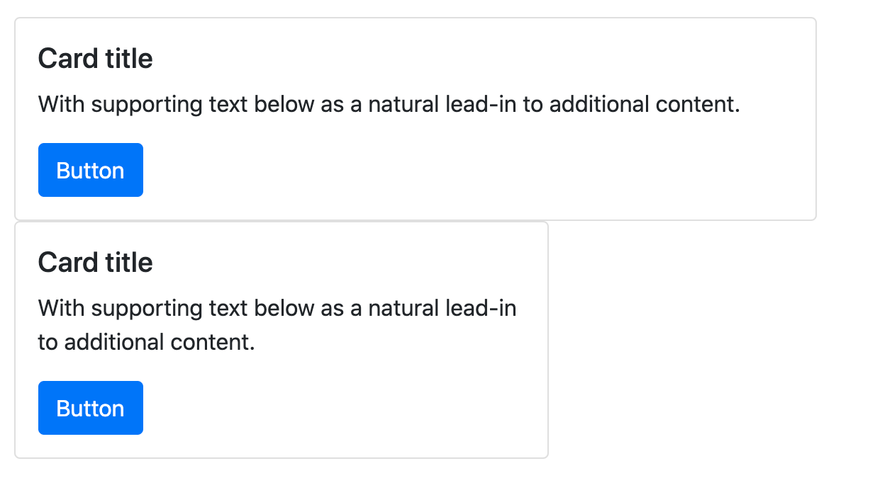
Using utilities

Slide 19
Using custom CSS
We can use custom CSS to control the width of the card. For example,
<div class="card" style="width: 18rem;"></div>

Slide 20
Text alignment
We can add text alignment by adding text-* next to card class
<div class="card text-center" style="width: 18rem;"> </div>

Slide 21
Navigation
<div class="card text-center">
<div class="card-header">
<ul class="nav nav-tabs card-header-tabs">
<li class="nav-item">
<a class="nav-link active" aria-current="true" href="#">Active</a> </li> <li class="nav-item"> <a class="nav-link" href="#">Link</a> </li>
<li class="nav-item"> <a class="nav-link disabled" href="#" tabindex="-1" aria-disabled="true">Disabled</a> </li>
</ul>
</div>
<div class="card-body">
<h5 class="card-title">Special title treatment</h5>
<p class="card-text">With supporting text below as a natural lead-in to additional content.</p> <a href="#" class="btn btn-primary">Go somewhere</a>
</div> </div>

Slide 22
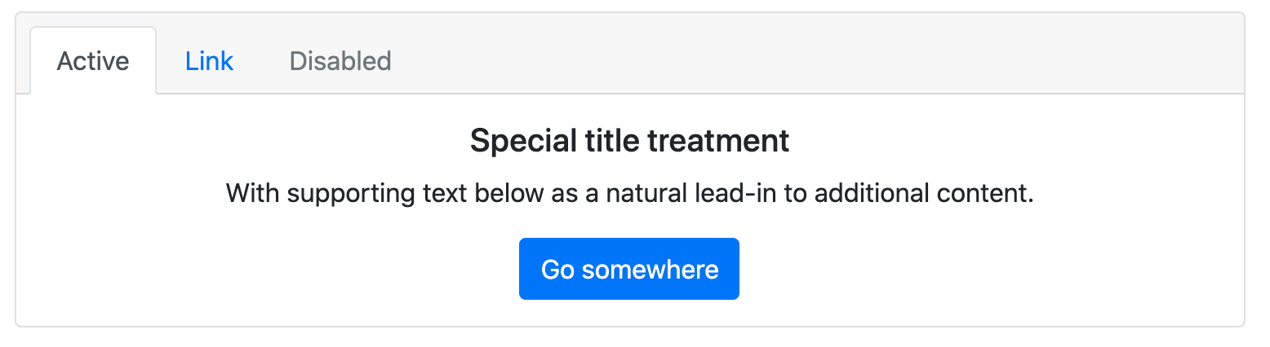
Navigation

Slide 23
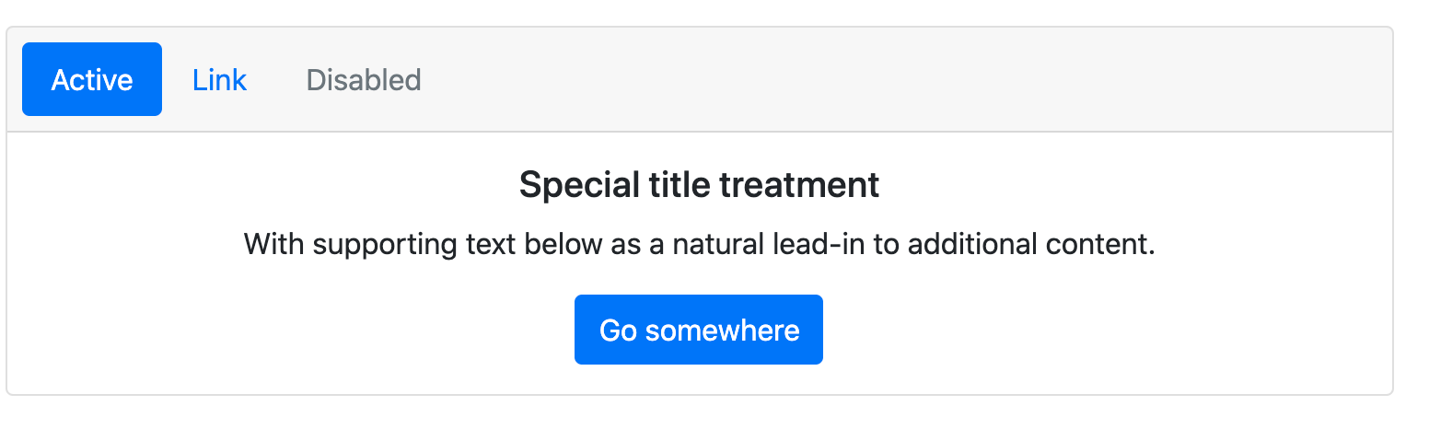
Navigation
We can also use pills by adding classes “nav-pills card-header-pills” next to nav class in the ul
<ul class="nav nav-pills card-header-pills"> </ul>

Slide 24
Image caps
Similar to headers and footers, cards can include top and bottom “image caps”—images at the top or bottom of a card.
<div class="card mb-3">
<img src="..." class="card-img-top" alt="...">
<div class="card-body"> <h5 class="card-title">Card title</h5>
<p class="card-text">This is a wider card with supporting text below as a natural lead-in to additional content. This content is a little bit longer.</p>
<p class="card-text"><small class="text-muted">Last updated 3 mins ago</small></p> </div> </div>

Slide 25
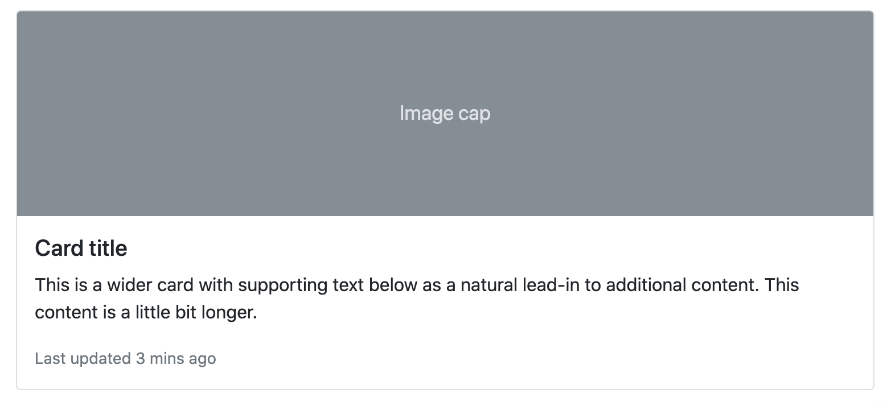
Image caps

Slide 26
Image caps
<div class="card">
<div class="card-body">
<h5 class="card-title">Card title</h5>
<p class="card-text">This is a wider card with supporting text below as a natural lead-in to additional content. This content is a little bit longer.</p>
<p class="card-text"><small class="text-muted">Last updated 3 mins ago</small></p>
</div>
<img src="..." class="card-img-bottom" alt="...">
</div>

Slide 27
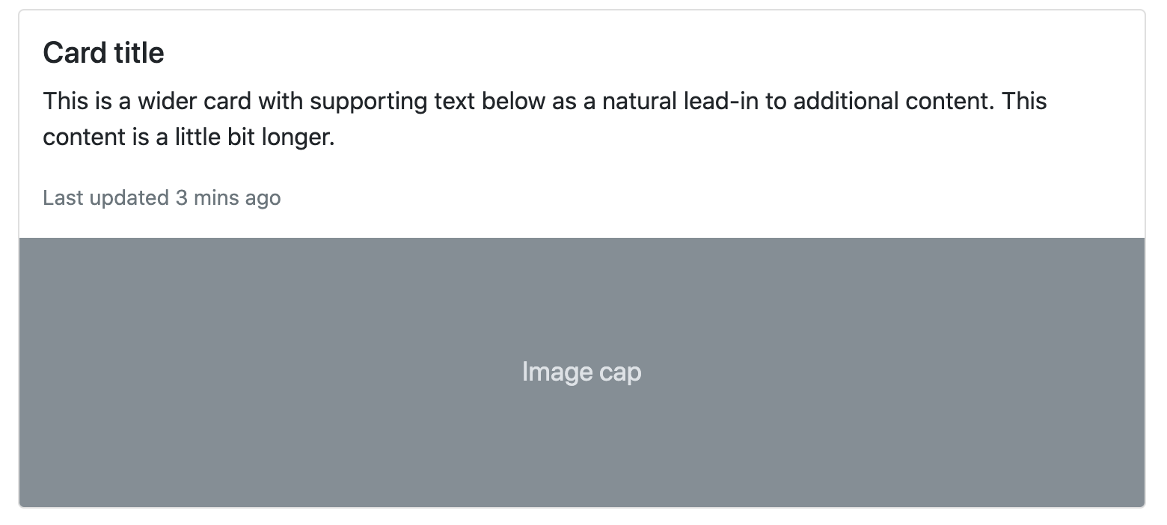
Image caps

Slide 28
Image overlays
Turn an image into a card background and overlay your card’s text. Depending on the image, you may or may not need additional styles or utilities.
<div class="card bg-dark text-white">
<img src="..." class="card-img" alt="...">
<div class="card-img-overlay">
<h5 class="card-title">Card title</h5>
<p class="card-text">This is a wider card with supporting text below as a natural lead-in to additional content. This content is a little bit longer.</p>
<p class="card-text">Last updated 3 mins ago</p>
</div> </div>

Slide 29
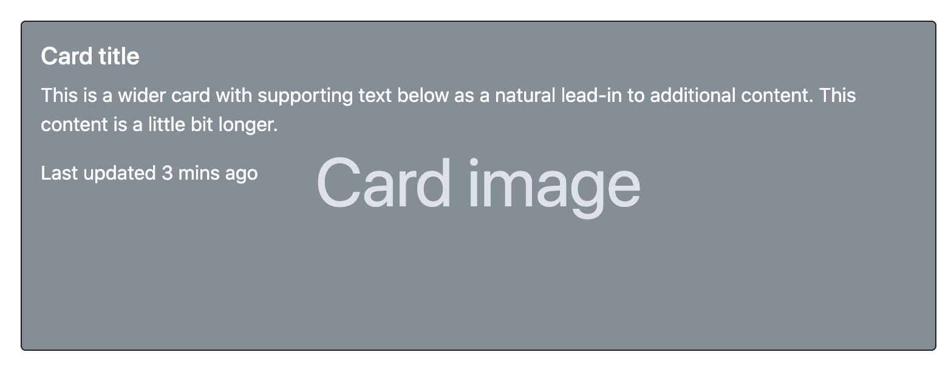
Image overlays

Slide 30
Horizontal
Using a combination of grid and utility classes, cards can be made horizontal in a mobile-friendly and responsive way. In the example below, we remove the grid gutters with .g-0 and use .col-md-* classes to make the card horizontal at the md breakpoint. Further adjustments may be needed depending on your card content.
<div class="card mb-3" style="max-width: 540px;">
<div class="row g-0">
<div class="col-md-4">
<img src="..." class="img-fluid rounded-start" alt="...">
</div>
<div class="col-md-8">
<div class="card-body">
<h5 class="card-title">Card title</h5>
<p class="card-text">This is a wider card with supporting text below as a natural lead-in to additional content. This content is a little bit longer.</p>
<p class="card-text"><small class="text-muted">Last updated 3 mins ago</small></p>
</div>
</div>
</div>
</div>

Slide 31
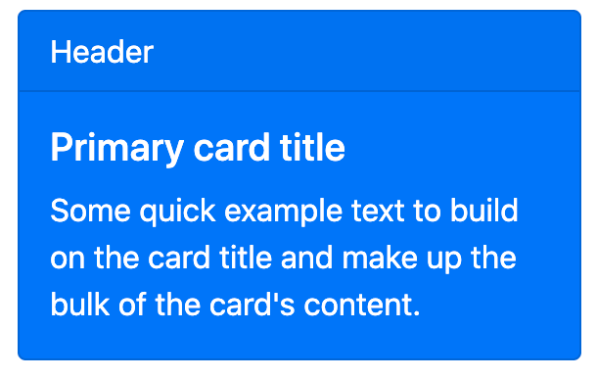
Background and color
<div class="card text-* bg-* mb-3" style="max-width: 18rem;">
<div class="card-header">Header</div>
<div class="card-body">
<h5 class="card-title">Primary card title</h5>
<p class="card-text">Some quick example text to build on the card title and make up the bulk of the card's content.</p>
</div>
</div>

Slide 32
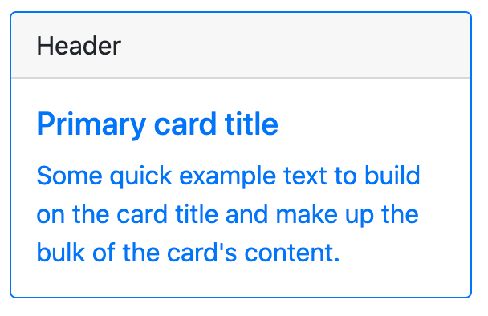
Border
Use border utilities to change just the border-color of a card. Note that you can put .text-{color} classes on the parent .card or a subset of the card’s contents as shown below.
<div class="card border-primary mb-3" style="max-width: 18rem;">
<div class="card-header">Header</div>
<div class="card-body text-primary">
<h5 class="card-title">Primary card title</h5>
<p class="card-text">Some quick example text to build on the card title and make up the bulk of the card's content.</p>
</div>
</div>

Slide 33
Mixins utilities
You can also change the borders on the card header and footer as needed, and even remove their background-color with .bg-transparent.
<div class="card border-success mb-3" style="max-width: 18rem;">
<div class="card-header bg-transparent border-success">Header</div>
<div class="card-body text-success">
<h5 class="card-title">Success card title</h5>
<p class="card-text">Some quick example text to build on the card title and make up the bulk of the card's content.</p>
</div>
<div class="card-footer bg-transparent border-success">Footer</div>
</div>

Slide 34
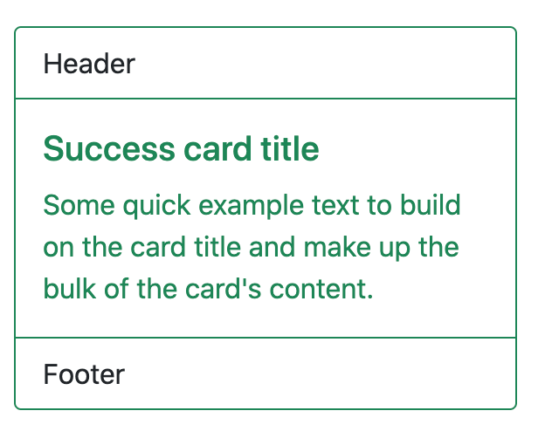
Mixins utilities

Slide 35
Card groups
Use card groups to render cards as a single, attached element with equal width and height columns. Card groups start off stacked and use display: flex; to become attached with uniform dimensions starting at the sm breakpoint.
<div class="card-group">
<div class="card">
<img src="..." class="card-img-top" alt="...">
<div class="card-body">
<h5 class="card-title">Card title</h5>
<p class="card-text">This is a wider card with supporting text below as a natural lead-in to additional content. This content is a little bit longer.</p>
<p class="card-text"><small class="text-muted">Last updated 3 mins ago</small></p>
</div>
</div> </div>. Repeat the card more two times

Slide 36
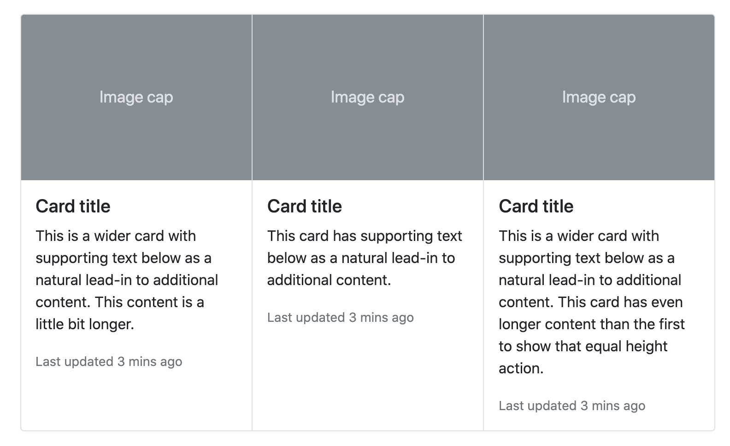
Card groups

Slide 37
Card groups
When using card groups with footers, their content will automatically line up.
<div class="card-group">
<div class="card">
<img src="..." class="card-img-top" alt="...">
<div class="card-body">
<h5 class="card-title">Card title</h5>
<p class="card-text">This is a wider card with supporting text below as a natural lead-in to additional content. This content is a little bit longer.</p>
</div>
<div class="card-footer">
<small class="text-muted">Last updated 3 mins ago</small>
</div>
</div></div> Repeat the card more two times

Slide 38
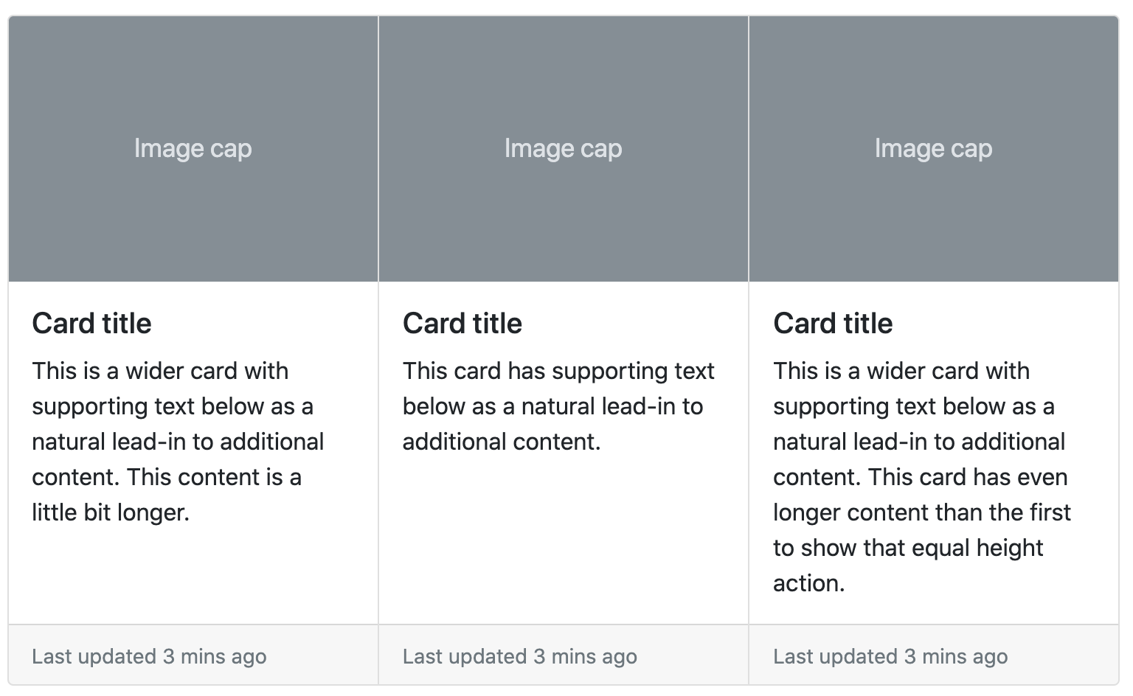
Card groups

Slide 39
Grid cards
Use the Bootstrap grid system and its .row-cols-* to control how many grid columns (wrapped around your cards) you show per row. For example, here’s .row-cols-1 laying out the cards on one column, and .row-cols-md-2 splitting four cards to equal width across multiple rows, from the medium breakpoint up.
<div class="row row-cols-1 row-cols-md-2 g-4">
<div class="col">
<div class="card">
<img src="..." class="card-img-top" alt="...">
<div class="card-body">
<h5 class="card-title">Card title</h5>
<p class="card-text">This is a longer card with supporting text below as a natural lead-in to additional content. This content is a little bit longer.</p>
</div>
</div>
</div> </div> Repeat the card more three times

Slide 40
Equal height
When you need equal height, add .h-100 to the cards. If you want equal heights by default, you can set $card-height: 100% in Sass. Just like with card groups, card footers will automatically line up.
<div class="row row-cols-1 row-cols-md-3 g-4">
<div class="col">
<div class="card h-100">
<img src="..." class="card-img-top" alt="...">
<div class="card-body">
<h5 class="card-title">Card title</h5>
<p class="card-text">This is a longer card with supporting text below as a natural lead-in to additional content. This content is a little bit longer.</p>
</div>
</div>
</div> Repeat the card more three times

Slide 41
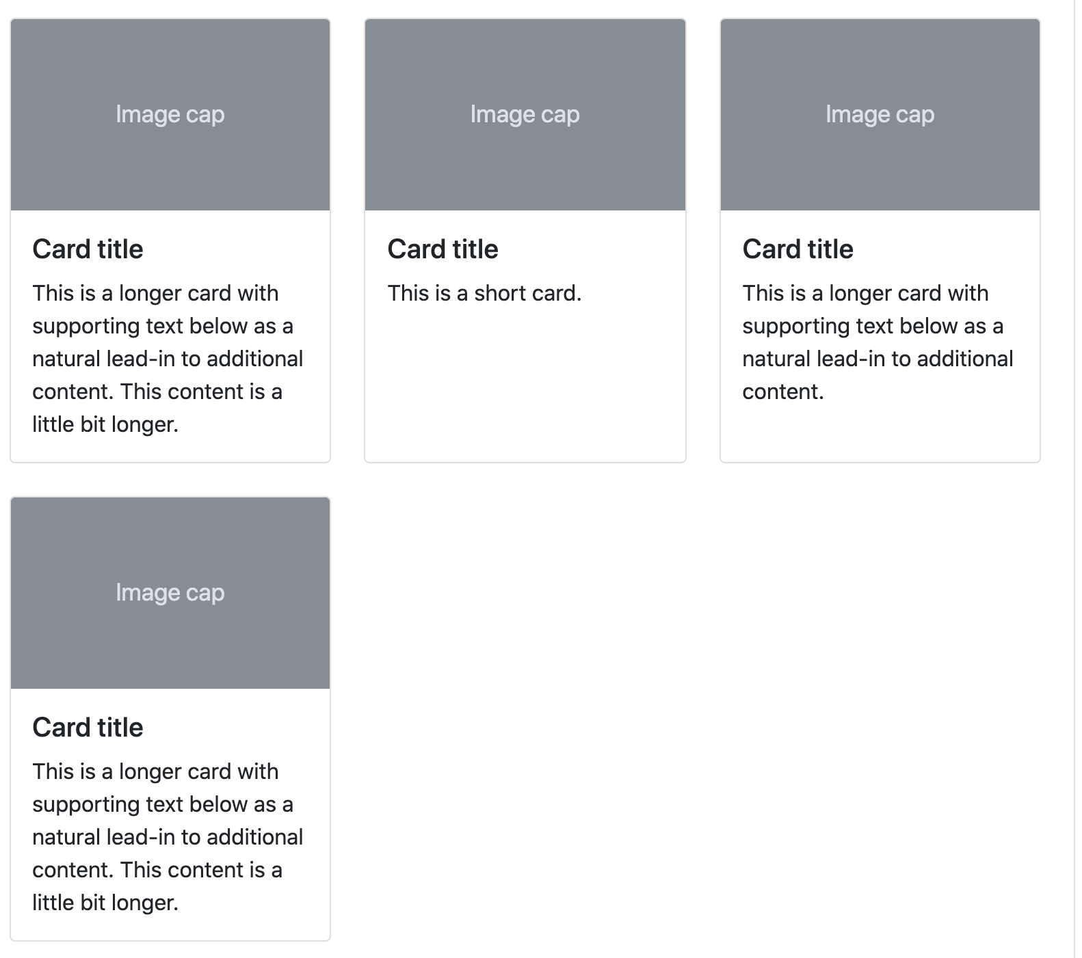
Equal height

